Slide 1



TRC1603 Deep Shear Wave Velocity Profiling in Northeast Arkansas
Ashraf Kamal Himel¹, MSc. EIT
Clinton M. Wood, Ethan Baker, Mike Deschenes
¹Department of Civil Engineering, The University of Arkansas, Fayetteville, USA.
2019 TRC Meeting
Hot Springs, AR; 15 August, 2019

Slide 2
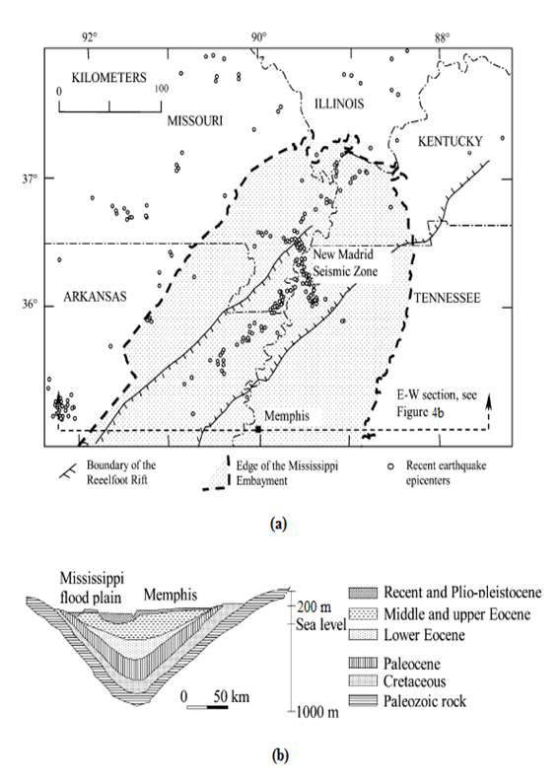
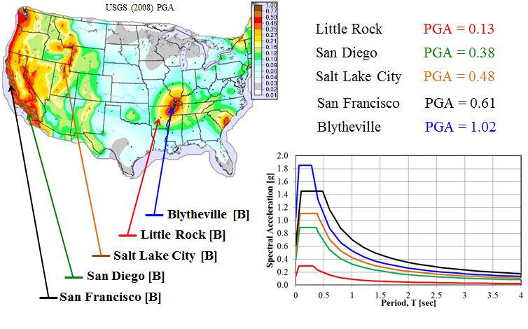
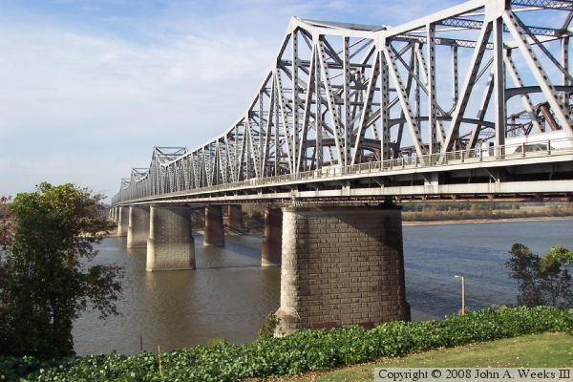
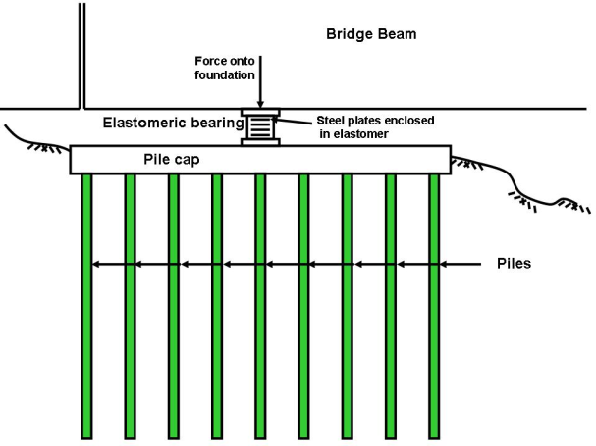
Arkansas Department of Transportation (ARDOT)
Soft Sediments
High Design Ground Motions
$$$$ Highway Structures
+
=
Blytheville PGA=1.02
Little Rock PGA=0.13
Salt Lake City PGA=0.48
San Diego PGA=0.38
San Francisco PGA=0.61
Hashash and Park 2001

Slide 3

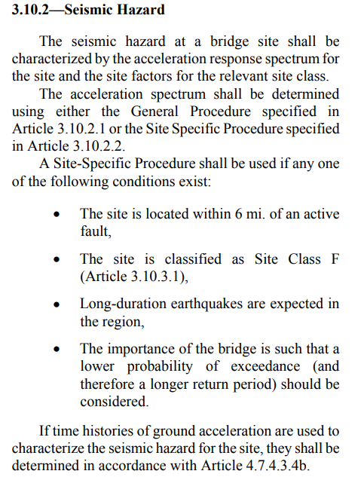
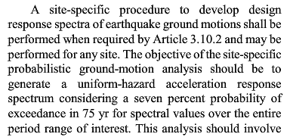
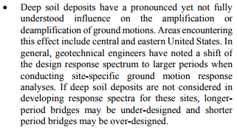
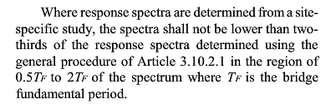
AASHTO Seismic Bridge Design Guide Specifications
Works well in simplified procedure using Vs100
3000 ft
Soil
~100 ft
Bedrock
Mississippi Embayment
Typical AASHTO Site

Slide 4
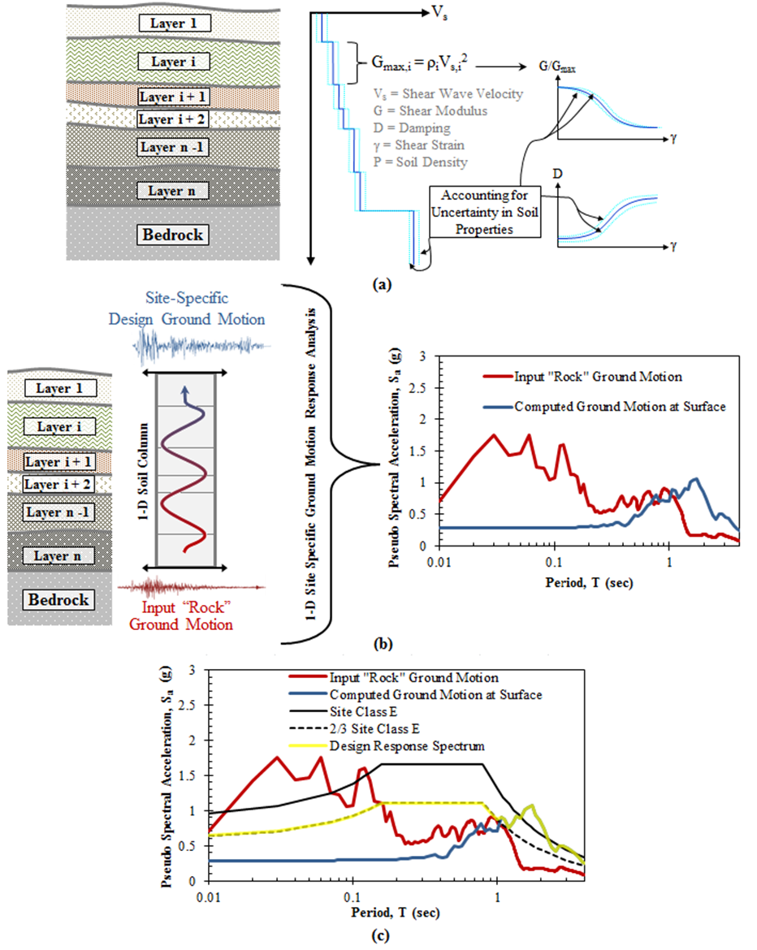
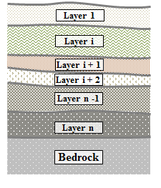
Site Specific Ground Motion Response Analysis (SSGMRA)
Vs Profiles/
Soil Layering
Site Response Analysis
Lower design ground motions according to AASHTO
Varies with site location and far less certain below 600 foot.

Slide 5
Project Objectives
Design a methodology to develop shear wave velocity (V_{s}) profiles down to bedrock in the Mississippi Embayment
Develop V_{s} profiles for 15 sites located in NEA
Conduct SSGMRA for a site in NEA
Demonstrate bridge design cost-savings potential of SSGMRA at said site
Develop a 3D V_{s} model for NEA

Slide 6
Surface Wave Methods Used
Active-source (sledgehammer) linear-array
  MASW: Multi-channel Analysis of Surface Waves
Active-source (Vibroseis) linear-array (at select sites)
  MASW: Multi-channel Analysis of Surface Waves
Ambient-wavefield (microtremor) circular-array
  MAM: Microtremor Array Measurements
    HFK: High-resolution Frequency-Wavenumber
    MSPAC: Modified Spatial Autocorrelation
  Single Station
    H/V: Horizontal-to-Vertical Spectral Ratio

Slide 7
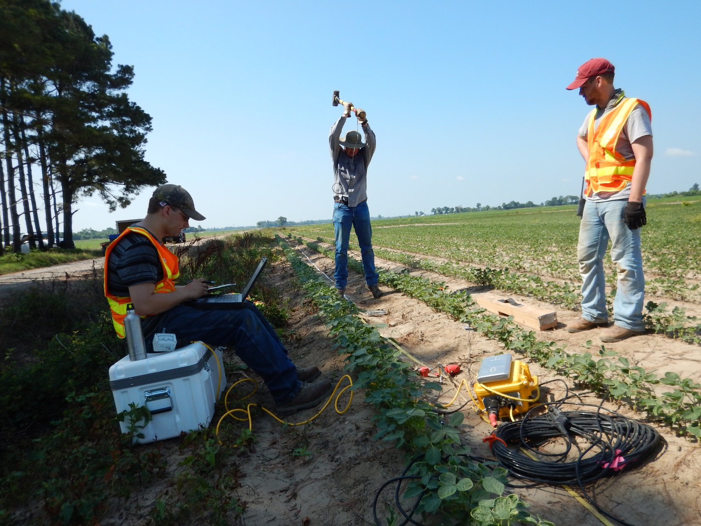
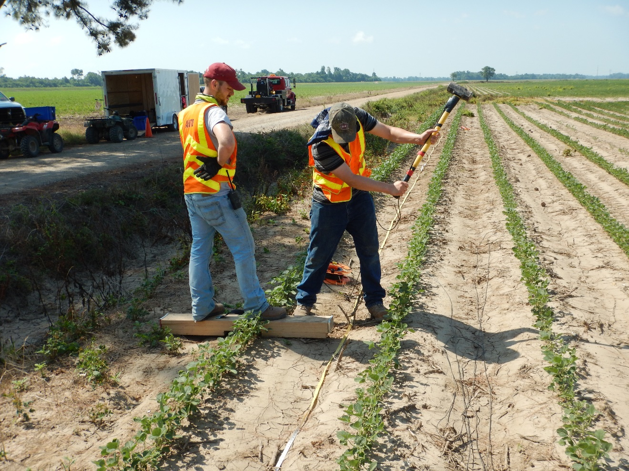
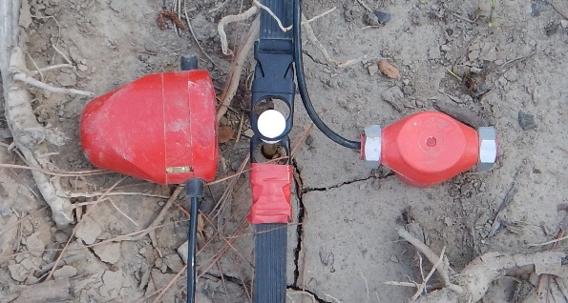
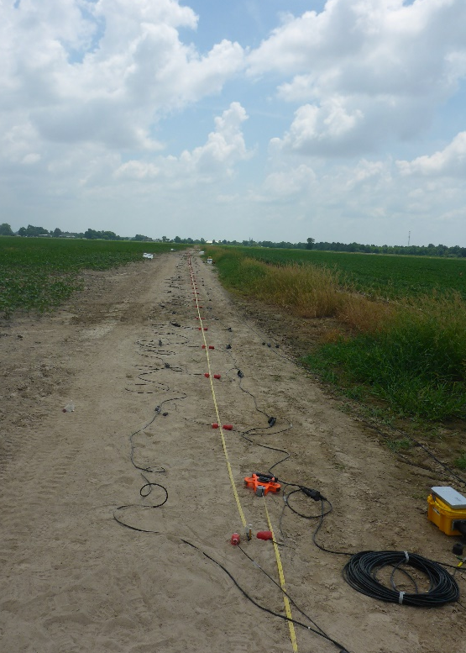
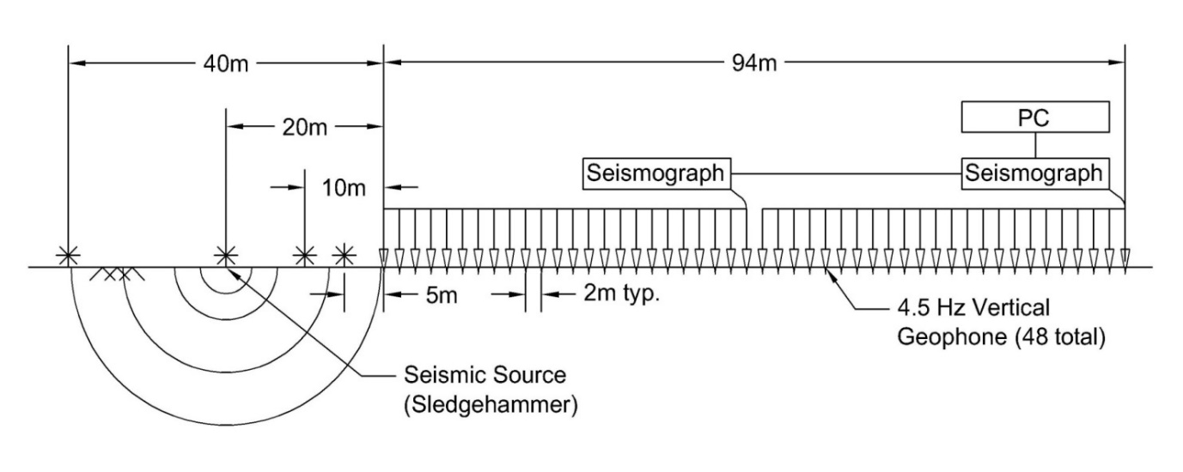
Active-Source Sledgehammer Testing
Linear array of 24-48 4.5-Hz vertical and horizontal geophones
Equal spacing of 2m (48-94 m long array)
Four different source-offset locations (5, 10, 20 & 30m)
Horizontal
Vertical

Slide 8
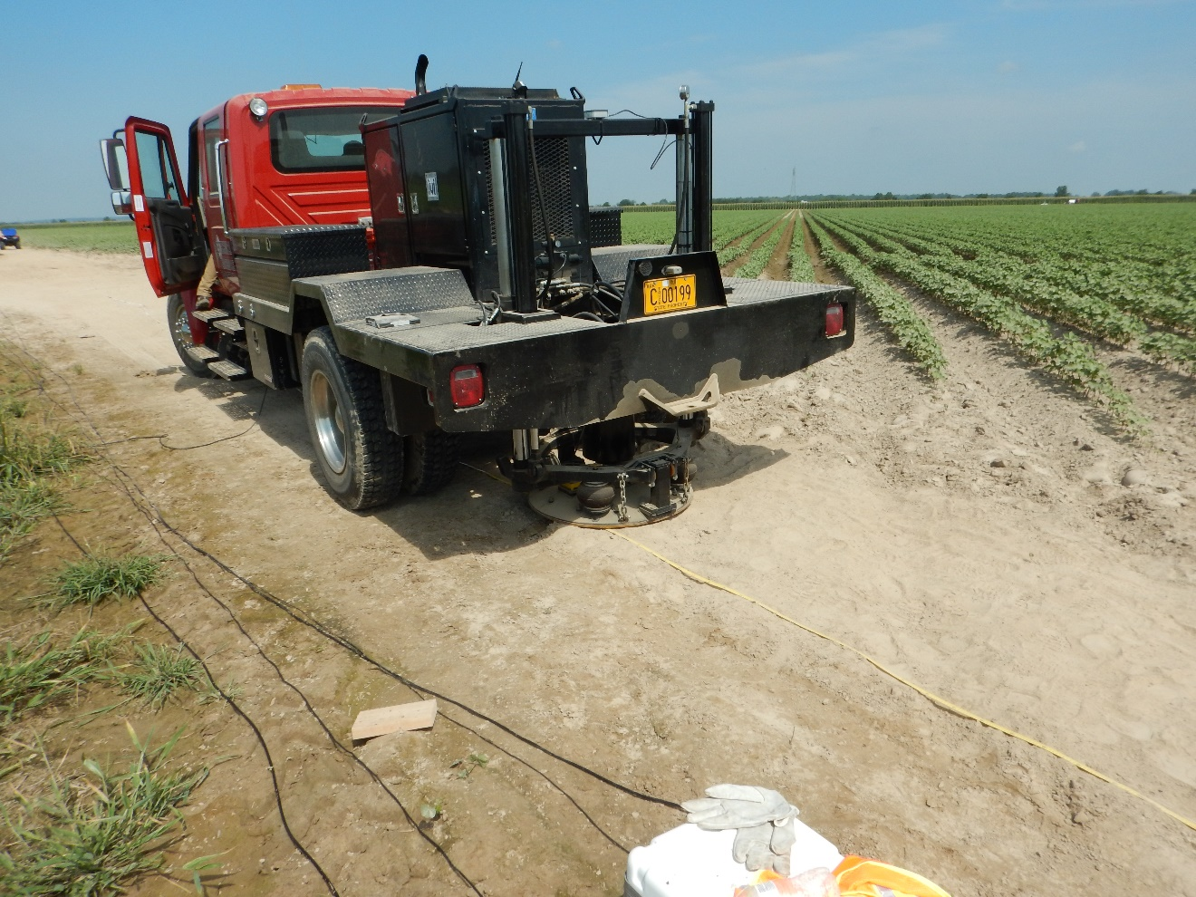
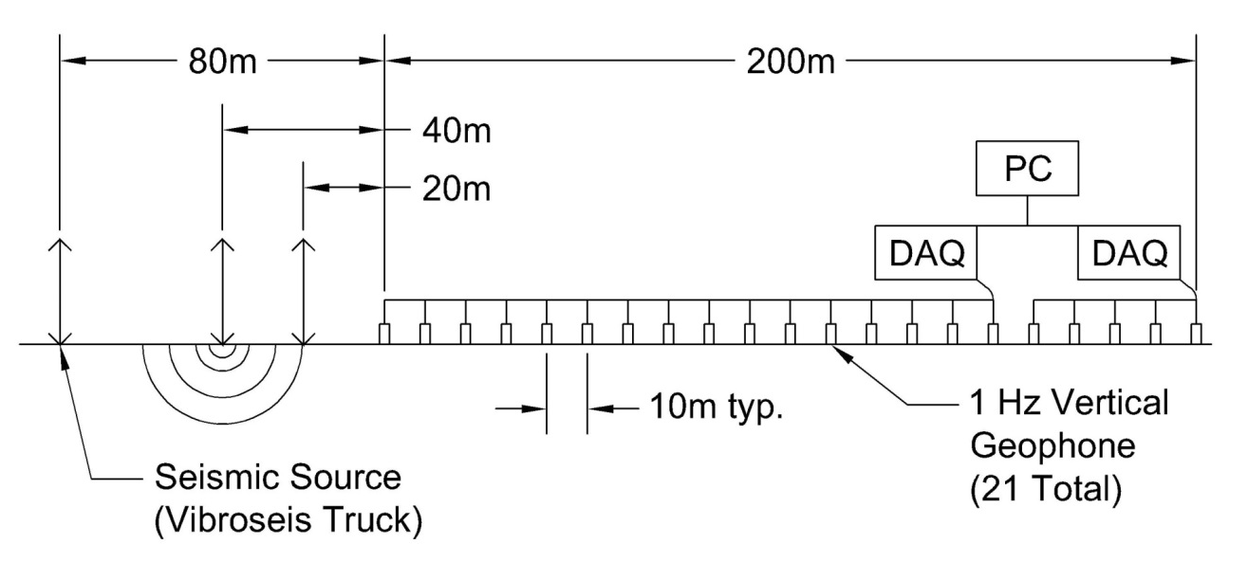
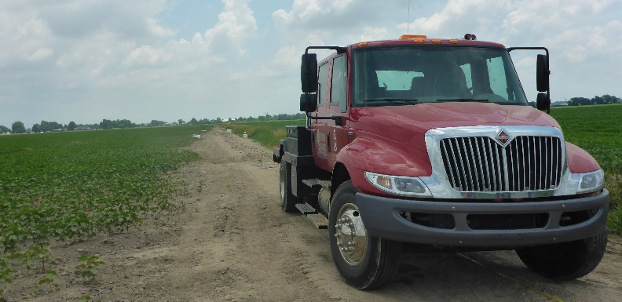
Active-Source Vibroseis Testing
Linear array of 24 4.5-Hz vertical geophones
Equal spacing of 4 m (94 m long array)
Three different source-offset locations (10, 20, & 40m)
40m
94m
20m
10m
4m
4.5 Hz Geophones

Slide 9
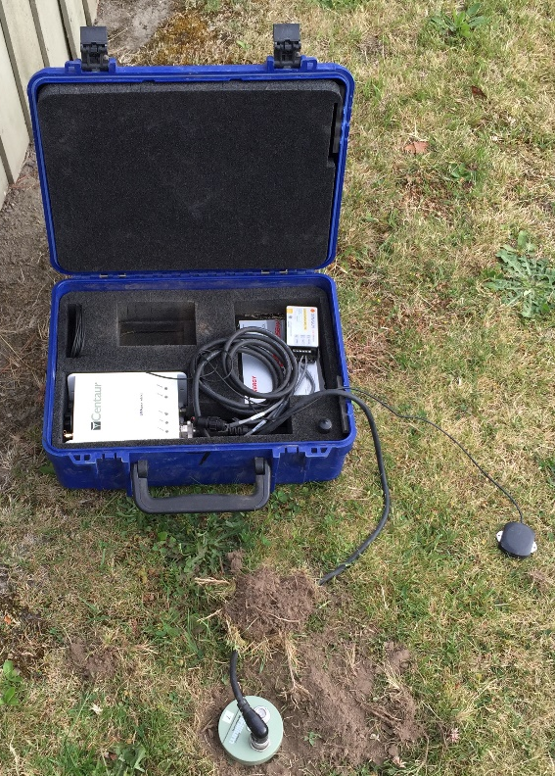
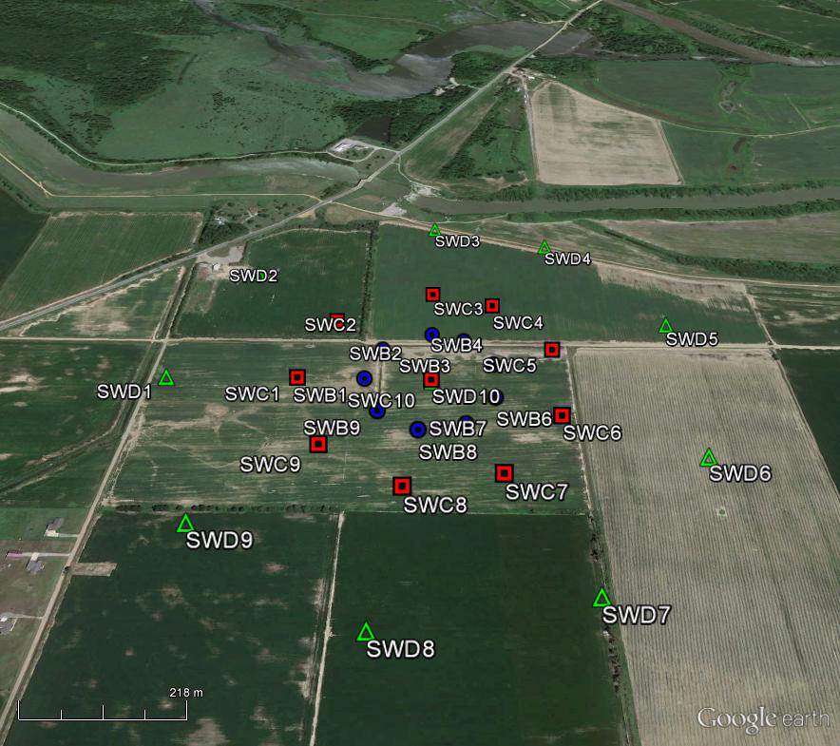
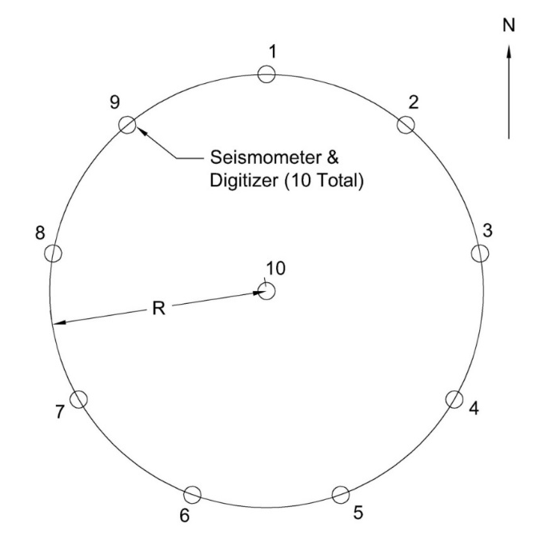
Ambient-Wavefield (microtremor) Testing
Circular arrays of 10 broadband seismometers (20-120s T)
Array diameters of 50, 200, 500, and 1000 m
Recording times of 30 – 120 min at each array
Broadband Seismometer
MASW
Up to 1000 m dia arrays

Slide 10
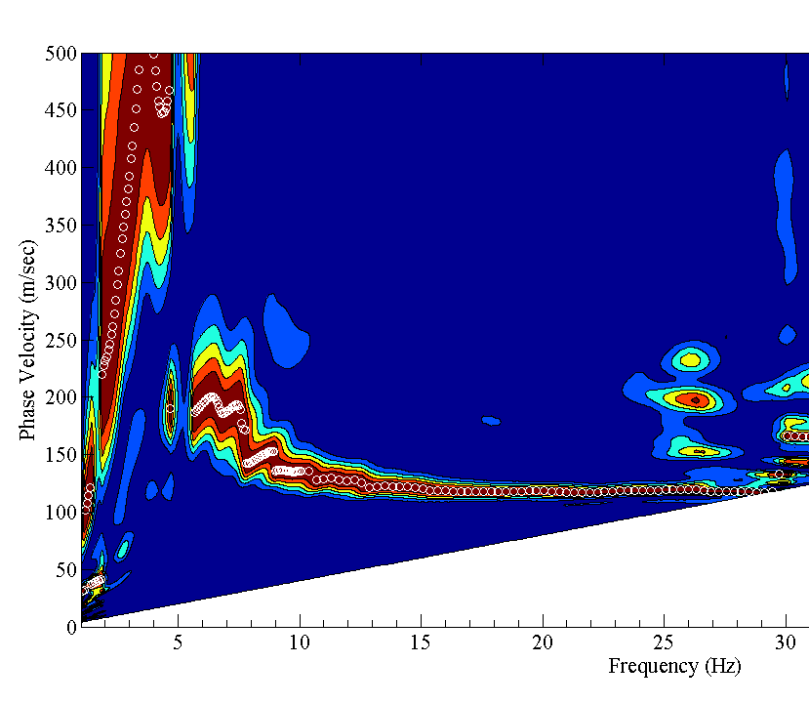
Active-Source Sledgehammer Processing
Rayleigh and Love wave surface wave analysis
Frequency domain beamformer (FDBF) or standard FK
2D Transformation
Time (t) Frequency (F)
Space (x) Wavenumber (K)
V_{R} = F (2π/K)
Mode Jumps
Phase Velocity (m/s)
Frequency (Hz)

Slide 11
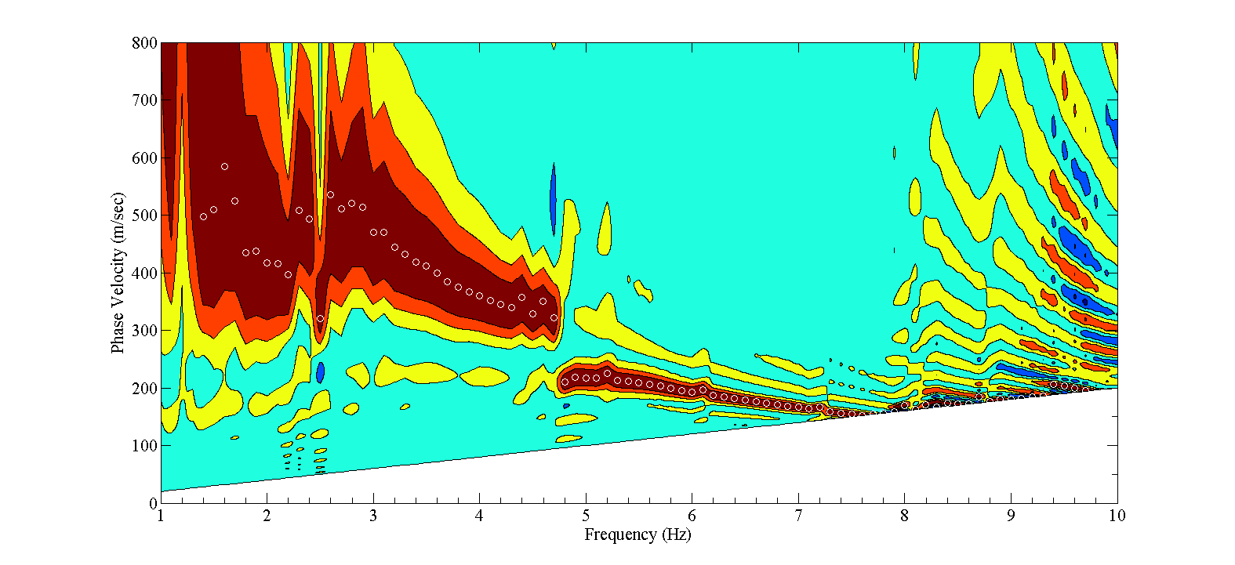
Active-Source Vibroseis Processing
Stepped-sine testing from 30 – 2 Hz (ΔF = 0.25 Hz)
1/1
2/1
3/1
4/1
1/1
FDBF
1/2
Cross Power Spectra
Phase
1/3
1/4
Mode Jumps
Frequency
Phase Velocity (m/s)
Frequency (Hz)

Slide 12
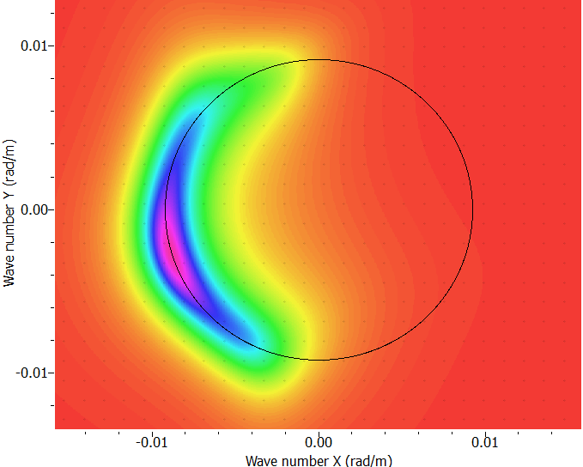
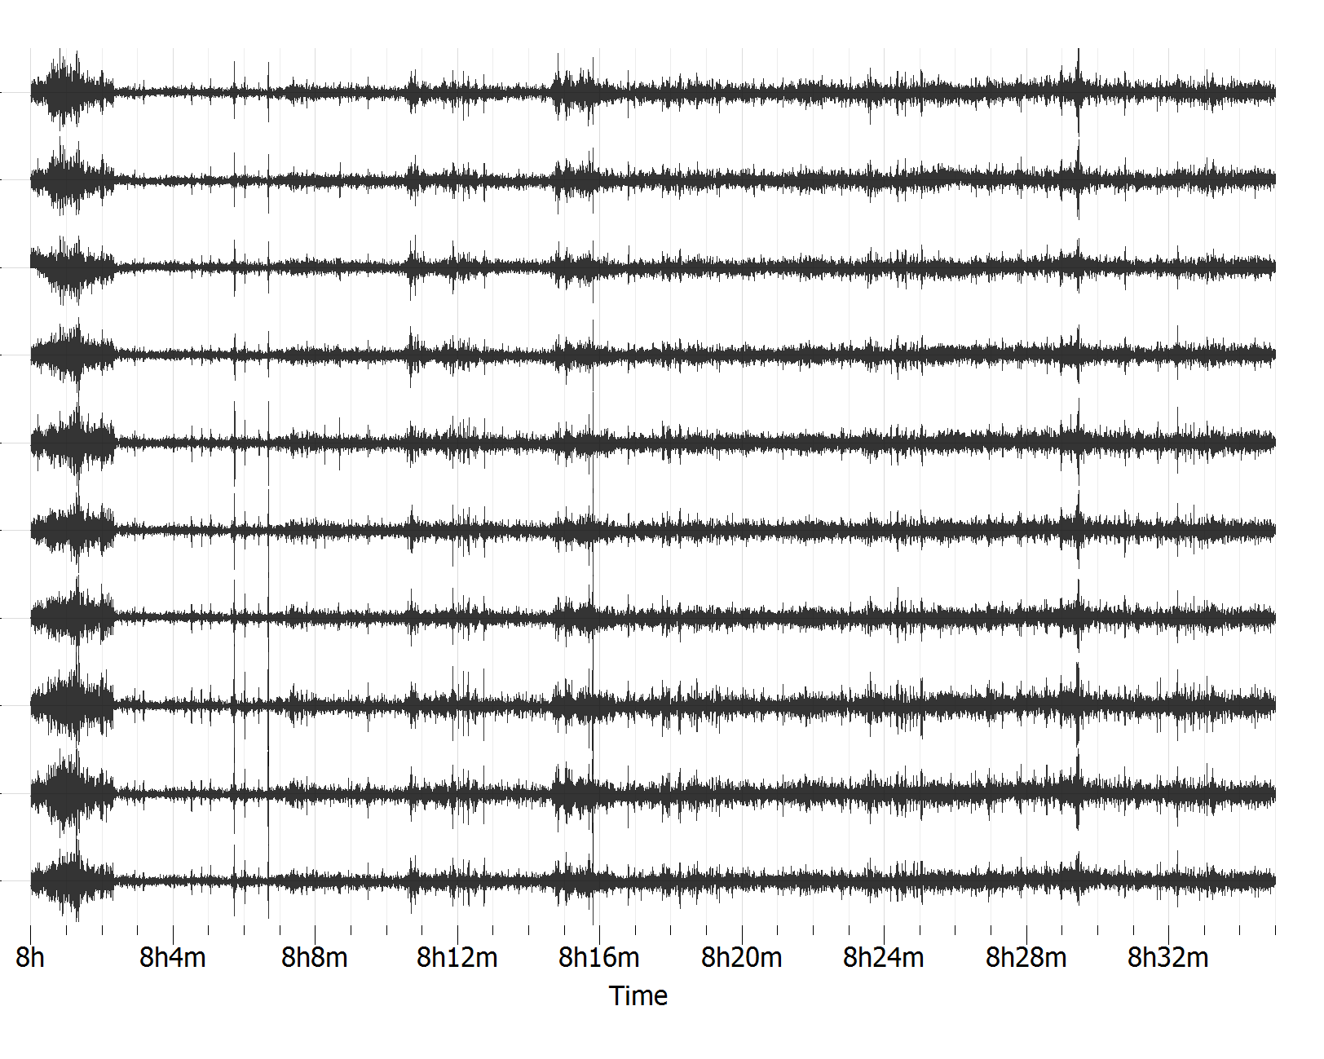
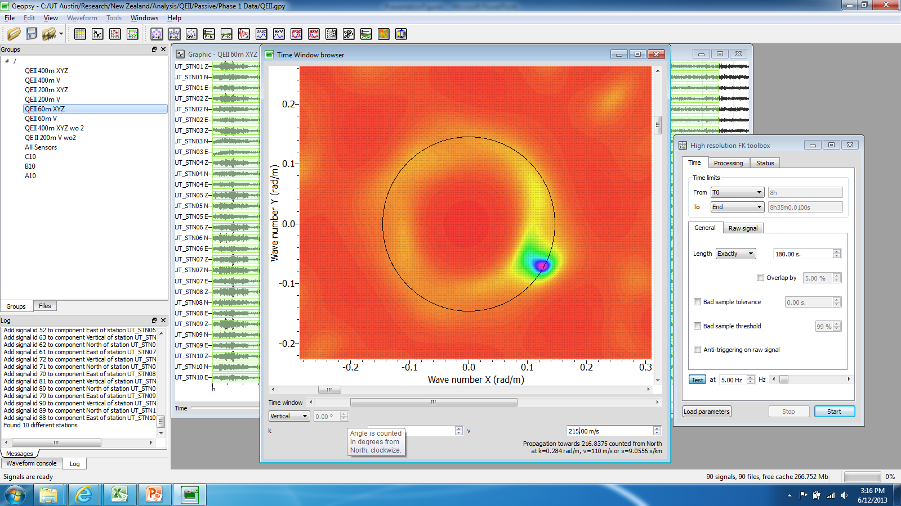
MAM: Ambient-Wavefield Processing
N
2D High-resolution FK (HFK)
Modified Spatial Autocorrelation (MSPAC)
Vertical components = Rayleigh
Horizontal components = Love
F = 1.0 Hz
Ky (rad/m)
E
K
Station
K = 0.0092
V_{R} = 680 m/s
1
2
Kx (rad/m)
3
.
.
.
F = 5.0 Hz
Ky (rad/m)
E
K
10
K = 0.146
V_{R} = 215 m/s
Kx (rad/m)

Slide 13
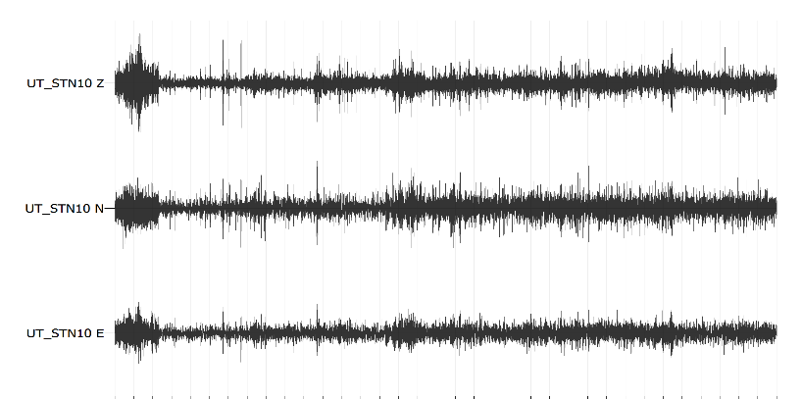
Single Station: Ambient-Wavefield Processing
H/V
Vertical
North
East
Low freq peak (0.21 Hz) used in joint-inversion to help constrain depth to bedrock
High freq peak not stable in time (varies between array data collection times)

Slide 14
Results for Monette Site

Slide 15
Results for Monette Site
Area of Complex Wave Propagation
Extremely Challenging Data processing
Inversion Details
Geopsy software used for inversion
Neighborhood search algorithm (Wathelet et al. 2004)
Multi-mode, joint inversion of:
  Rayleigh wave dispersion data
  Love wave dispersion data
  H/V peak (theoretical Rayleigh wave elipicity)
layered velocity model based on geologic and well data in the area
> 2 Million velocity models for each analysis
Median of top 1000 Vs profiles from inversion selected as “best”/most likely Vs profile

Slide 16
Results for Monette Site
Memphis Sand

Slide 17
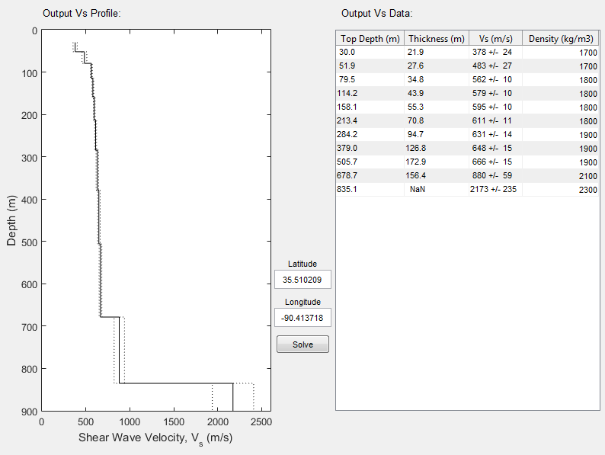
Vs profiles from all 15 sites
Geologic model of Embayment
+
=
3D Shear wave Velocity Model

Slide 18
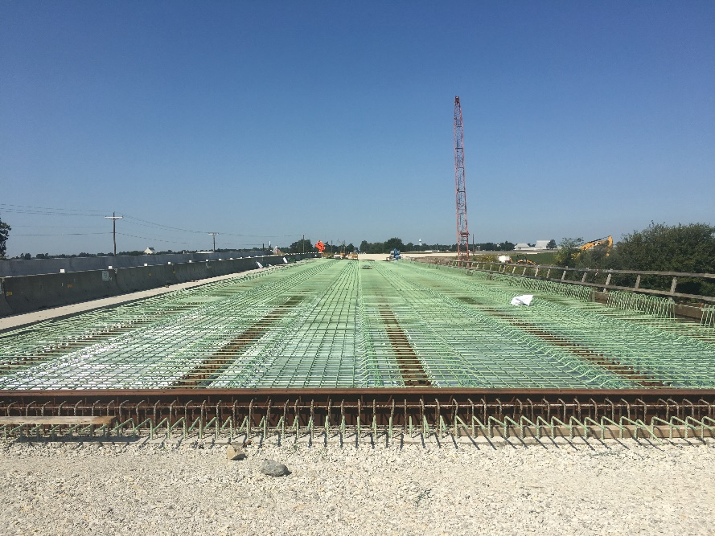
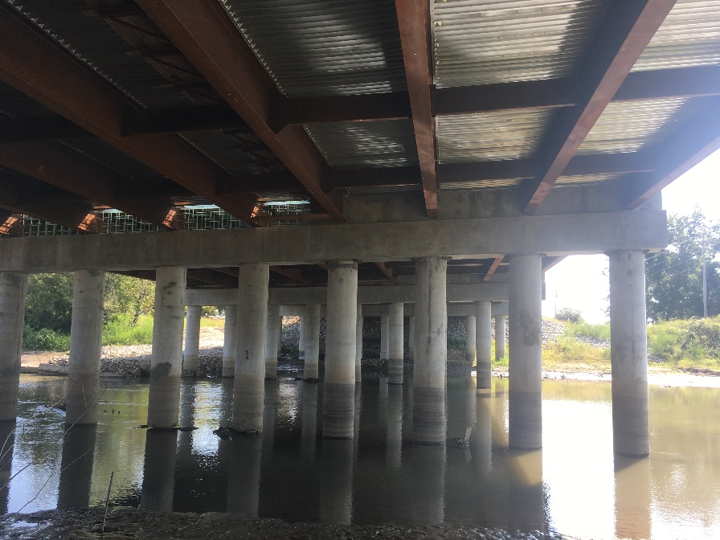
Site Response Analysis at Example Bridge Site in Monette, AR and Cost Savings Analysis
Specifications of Bridge and Site
Original Bid was $2,821,743.30
Four lane 78 ft width
327 ft long continuous steel beam bridge with 9 beams
Six bents with 9 piles per bent
18” diameter end bent piles and 24” diameter intermediate bent piles
Structural period of 1.3 seconds and 0.3 seconds
Site characterized by loose to medium dense sandy soil deposits with a clay layer between 3-6 ft below the surface
General Procedure Design Values
Seismic Site Class D based on SPT
PGA=0.917g
S_{DS}=1.641g
S_{D1}=0.694g
AASHTO Performance Zone 4

Slide 19
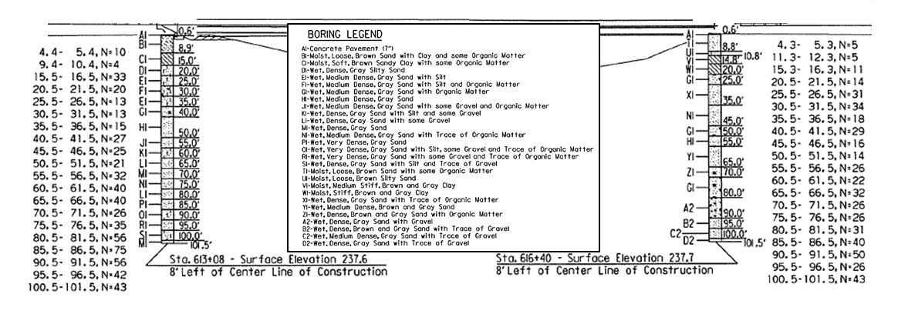
Site Response Analysis at Example Bridge Site in Monette, AR and Cost Savings Analysis
Vs30=215 m/s
Input ground motions taken from McGuire et al. (2001) and spectrally matched to the Uniform Hazard Spectrum
Uncertainty in the Vs measurements was accounted for by randomly selecting 10 Vs profiles from the top 1000 Vs profiles from over 2 million Vs profiles which were considered during the dynamic site characterization efforts.
Darendeli (2001) modulus reduction and damping curves were modeled using the GQ/H model which accounts for shear strength correction at high strains
Site response conducted using Equivalent Linear (EQL) and completely Non-linear (NL) approaches in DEEPSOIL V6.1. Results weighted 50/50.
Site period 3.70 Seconds
Bedrock Depth =680 m (2230 ft)
Numerous loose sandy layers in the profile that are potentially liquefiable

Slide 20
Site Response Analysis at Example Bridge Site in Monette, AR and Cost Savings Analysis
Input Rock Spectrum
Nonlinear surface spectral acceleration
Final Design surface spectral acceleration

Slide 21
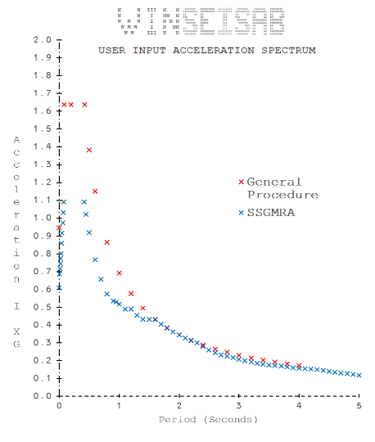
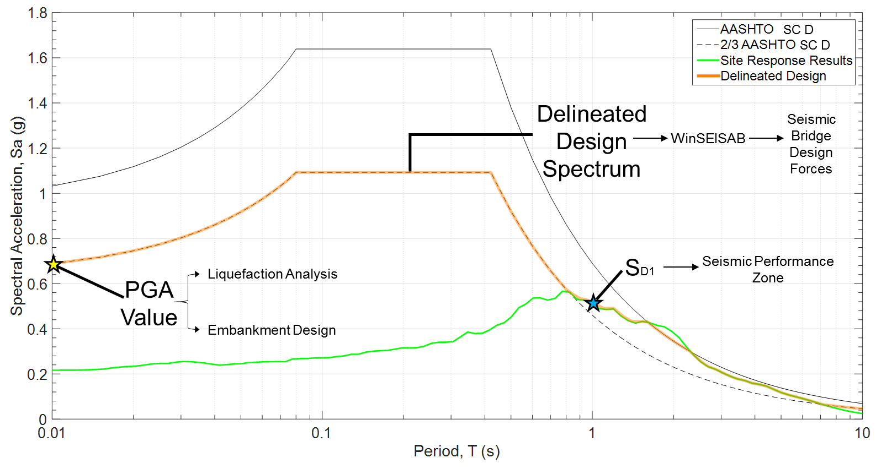
Site Response Analysis at Example Bridge Site in Monette, AR and Cost Savings Analysis
Bridge/Project aspects considered in Bridge Redesign
Seismic Site Classification based on shear wave velocity
Seismic Performance Zone based on Spectral Acceleration at 1 second period
Reduced Seismic demand on Bridge components
  Restraining blocks
  Column/pile size
  Pile length
Liquefaction Resistance
Embankment Design
Cost reductions and cost savings
are based on original bid items for
the bridge

Slide 22
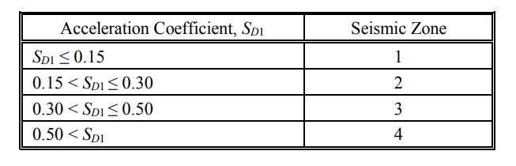
Site Response Analysis at Example Bridge Site in Monette, AR and Cost Savings Analysis
Bridge/Project aspects considered in Bridge Redesign
Seismic Site Classification based on Shear Wave Velocity
Seismic Performance Zone based on Spectral Acceleration at 1 second period
No change in either Seismic Site Classification or Performance Zone
Site classification groups are often so wide that one would need to be near an edge to possibly see an improvement.
Original S_{D1} value of 0.694g was too far from the cutoff for Seismic Zone 3 plus having liquefiable layers in the subsurface forced Seismic Zone 4

Slide 23
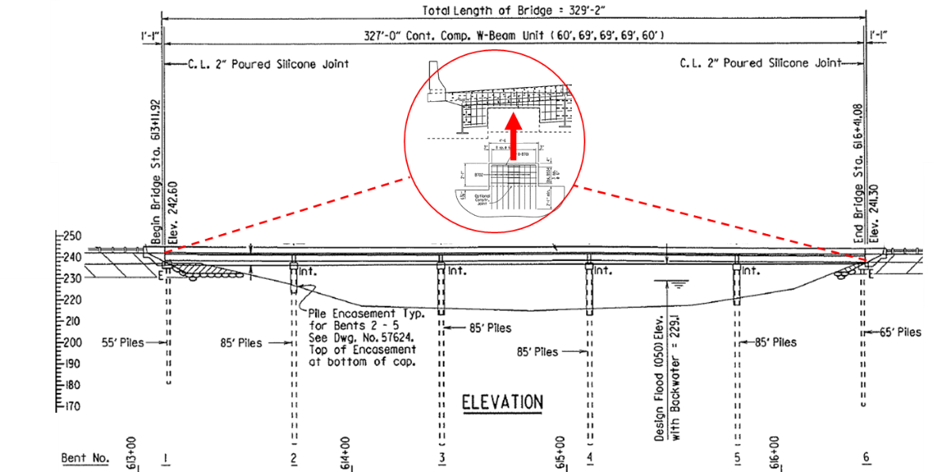
Site Response Analysis at Example Bridge Site in Monette, AR and Cost Savings Analysis
Bridge/Project aspects considered in Bridge Redesign
Reduced Seismic demand on Bridge components
  Restraining blocks
  Column/pile size
  Pile length
Small change in Restraining Block design (~$3500 Savings)
Piles
24” x 0.5”
18” x 0.5”
24” Column Structure
18” Column Structure
Reduce end bent pile lengths by 20 ft
Reduce intermediate bent pile lengths by 4 ft
$49,489.65 savings
Reduce end bent pile lengths by 20 ft
Reduce intermediate bent pile lengths by 14 ft and size of piling
$92,392.39 savings
23

Slide 24
Site Response Analysis at Example Bridge Site in Monette, AR and Cost Savings Analysis
Bridge/Project aspects considered in Bridge Redesign
Liquefaction Resistance
No significant change in liquefaction potential at the site. ($0 Savings)
Layers were simply too loose and original PGA too high to change the factor of safety.

Slide 25
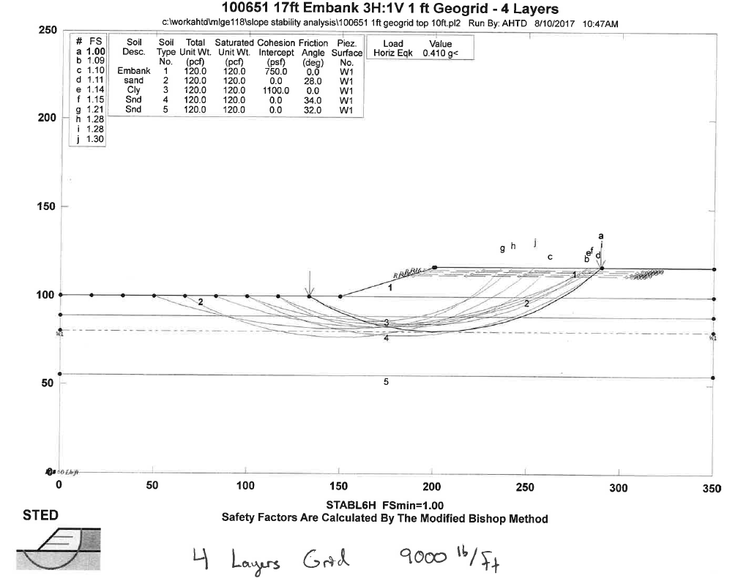
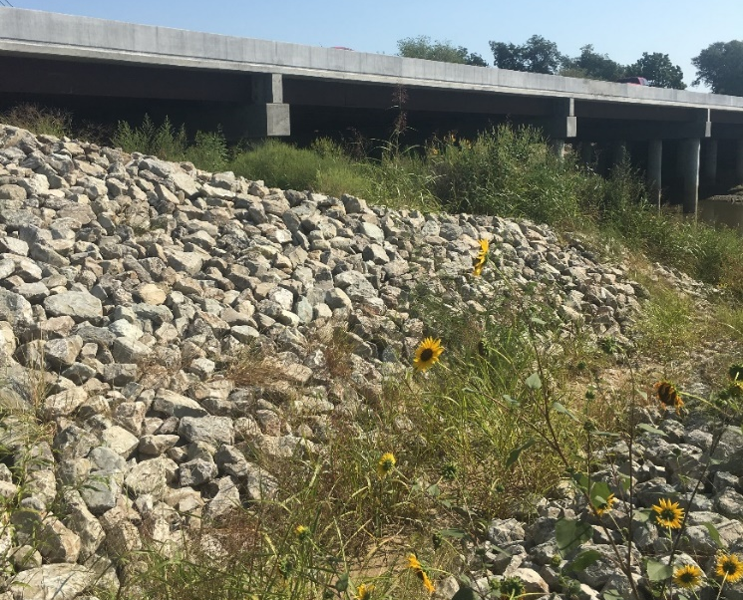

Site Response Analysis at Example Bridge Site in Monette, AR and Cost Savings Analysis
Bridge/Project aspects considered in Bridge Redesign
Embankment Design
Original embankment design called for eights layers of 9000 lb/ft Geogrid
With update PGA requirement were reduced to four layers of 2000 lb/ft Geogrid ($114,600 Savings)
Original Design
Redesign
22600 yd² of 9000 lbf/ft
10500 yd² of 2000 lbf/ft
SSGMRA

Slide 26
Site Response Analysis at Example Bridge Site in Monette, AR and Cost Savings Analysis
Bridge/Project Redesign Impacts
Original Bridge Bid was $2,821,743.30
 | Cost Savings for Monette Bridge
SSGMRA Benefits | 24" Column Structure | 18" Column Structure
AASHTO Site Classification | - | -
AASHTO Seismic Performance Zone | - | -
Liquefaction Analysis | $0 | $0
Bridge Design | $49,489.65 | $92,392.39
Embankment Design | $114,600.00 | $114,600.00
TOTAL | $164,089.65 | $206,992.39
Percent of Bridge Cost | 5.82% | 7.34%

Slide 27
Final Thoughts
Dynamic site characterization can be very challenging in Mississippi Embayment for depths greater than 300 ft due to lack of low frequency energy and complex wave propagation. However, using the methodology developed in the study Vs profiles can be developed to great depths (>3000 ft).
However, the development of the University of Arkansas Mississippi Embayment Velocity Model (UA_MEVM) allows site response studies to be conducted with one a shallow (~100 ft) Vs profile which is much easier to obtain.
Site response shows attenuation at short periods and amplification at long periods for an NEA site
5-10% estimated savings can be achieved for NEA bridges by performing SSGMRA (7% for this particular project)

Slide 28
Acknowledgement
This research would not have been possible without the hard work of graduate students Ethan Baker, Michael Deschenes, Ashraf Himel, Tim Moody, and Tyler Baker. Special thanks also goes out to Steve Peyton, Courtney Rome, Paul Tinsley, Matt Green, Joseph Jabo and others at ARDOT. Their advice and assistance was instrumental in the success of the project.

Slide 29
Questions?

